Slide 1
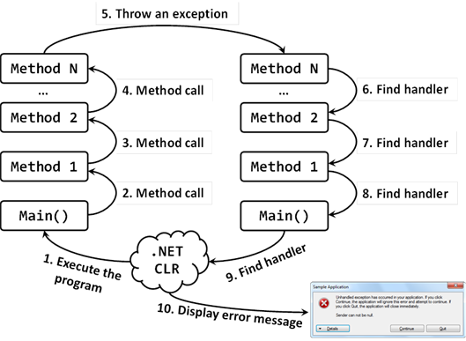


Exception Handling
Handling Errors During the Program Execution
SoftUni Team
Technical Trainers
Software University
https://softuni.bg

Slide 2
Have a Question?
sli.do
#prgm-for-qa

Slide 3
Table of Contents
What are Exceptions?
The System.Exception Class
Types of Exceptions and their Hierarchy
Handling Exceptions
try-catch-finally
Raising (Throwing) Exceptions
throw new Exception(…)

Slide 4

The Paradigm of Exceptions in OOP
What Are Exceptions?

Slide 5
What Are Exceptions?
Exceptions handle errors and problems at runtime
Throw an exception to signal about a problem
Catch an exception to handle the problem
if (size < 0)
throw new Exception("Size cannot be negative!");
try {
size = int.Parse(text);
} catch (Exception ex) {
Console.WriteLine("Invalid size!");
}

Slide 6
How Do Exceptions Work?
try
Run this code
Execute this code when there is an exception
catch
Always run this code
finally

Slide 7
The System.Exception Class
Exceptions in C# are objects
The System.Exception class is a base for all exceptions in CLR
Holds information about the error
Message – a text description of the exception
StackTrace – the snapshot of the stack at the moment of exception throwing
InnerException – exception that caused the current exception (if any)

Slide 8
Exception Hierarchy in .NET
System.Exception
System.SystemException
CustomException
System.NullReferenceException
System.FormatException
System.ArithmeticException
System.DividedByZeroException
System.OverflowException

Slide 9

Catching and Processing Errors
Handling Exceptions

Slide 10
Handling Exceptions
In C# exceptions can be handled by the try-catch construction
catch blocks can be used multiple times to process different exception types
try {
// Do some work that can raise an exception
}
catch (SomeException) {
// Handle the caught exception
}

Slide 11
Multiple Catch Blocks – Example
string s = Console.ReadLine();
try {
int.Parse(s);
Console.WriteLine(
"You entered a valid Int32 number {0}.", s);
}
catch (FormatException) {
Console.WriteLine("Invalid integer number!");
}
catch (OverflowException) {
Console.WriteLine(
"The number is too big to fit in Int32!");
}

Slide 12
Handling Exceptions
When catching an exception of a particular class, all its inheritors
Handles ArithmeticException and its descendants DivideByZeroException and OverflowException
try {
// Do some work that can cause an exception
}
catch (ArithmeticException ae) {
// Handle the caught arithmetic exception
}

Slide 13
Handling All Exceptions
For handling all exceptions (disregarding the exception type, even unmanaged) use the construction:
try
{
// Do some work that can raise any exception
}
catch
{
// Handle the caught exception
}

Slide 14
The Try-finally Statement
The try-finally statement ensures the finally block is always executed:
Used for execution of cleanup code, e. g. releasing resources
try {
// Do some work that can cause an exception
}
finally {
// This block will always execute
}

Slide 15
Try-finally – Example
static void TestTryFinally() {
Console.WriteLine("Code executed before try-finally.");
try {
string str = Console.ReadLine();
int.Parse(str);
Console.WriteLine("Parsing was successful.");
return; // Exit from the current method
} catch (FormatException) {
Console.WriteLine("Parsing failed!");
} finally {
Console.WriteLine("This cleanup code is always executed.");
}
Console.WriteLine("This code is after the try-finally block.");
}

Slide 16

Throwing Exceptions Using the "throw" Keyword

Slide 17
Using Throw Keyword
Throwing an exception with an error message:
Exceptions can accept message + another exception (cause):
This is called "chaining" exceptions
throw new ArgumentException("Invalid amount!");
try {
…
}
catch (SqlException sqlEx) {
throw new InvalidOperationException("Cannot save invoice.", sqlEx); }

Slide 18
Throwing Exceptions
Exceptions are thrown (raised) by the throw keyword
Notify the calling code in case of an error or problem
When an exception is thrown:
The program execution stops
The exception travels over the stack
Until a matching catch block is reached to handle it
Unhandled exceptions display an error message

Slide 19
Re-Throwing Exceptions
Caught exceptions can be re-thrown again:
try {
Int32.Parse(str);
}
catch (FormatException fe) {
Console.WriteLine("Parse failed!");
throw fe; // Re-throw the caught exception
}
catch (FormatException) {
throw; // Re-throws the last caught exception
}

Slide 20
Throwing Exceptions – Example
public static double Sqrt(double value) {
if (value < 0)
throw new System.ArgumentOutOfRangeException("value",
"Sqrt for negative numbers is undefined!");
return Math.Sqrt(value);
}
static void Main() {
try {
Sqrt(-1);
}
catch (ArgumentOutOfRangeException ex) {
Console.Error.WriteLine("Error: " + ex.Message);
throw;
}
}

Slide 21
Summary
Exceptions provide a flexible error handling mechanism
Try-catch allows exceptions to be handled
Unhandled exceptions cause error messages
Try-finally ensures a given code block is always executed
…
…
…
throw new Exception("Invalid size!");
try { … } catch (Exception ex) { … }

Slide 22









Questions?

Slide 23













SoftUni Diamond Partners

Slide 24
Trainings @ Software University (SoftUni)
Software University – High-Quality Education, Profession and Job for Software Developers
softuni.bg, about.softuni.bg
Software University Foundation
softuni.foundation
Software University @ Facebook
facebook.com/SoftwareUniversity
Software University Forums
forum.softuni.bg
24
Notes:
24

Slide 25

License
This course (slides, examples, demos, exercises, homework, documents, videos and other assets) is copyrighted content
Unauthorized copy, reproduction or use is illegal
© SoftUni – https://about.softuni.bg
© Software University – https://softuni.bg
Notes:
25

